Slide 1




Noida Institute of Engineering and Technology, Greater Noida
Introduction to Data Structure, Arrays, Searching and Sorting
UNIT-1
Unit: 1
Data Structures
Ms. Tamanna
Assistant Professor
(CSE)
Course Details (B Tech 3rd Sem)

Slide 2
Brief Introduction
Name : Tamanna
Designation : Assistant Professor
Institute : Noida Institute of Engineering & Technology Gr. Noida
Educational Qualification
M Tech in Computer Science & Engineering with Distinction.
B Tech in Computer Science &Engineering with Distinction.
Teaching Experience : 4 years
Research Experience : 1 year
Total Experience : 05 Years

Slide 3
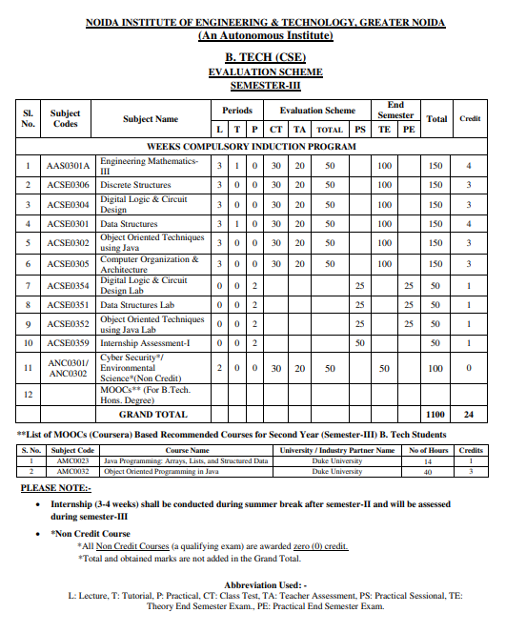
Evaluation Scheme

Slide 4
Unit I Syllabus
Introduction to data structure, Arrays, Searching, Sorting and Hashing
Data types: Primitive and non-primitive, Types of Data Structures- Linear & Non-Linear Data Structures. Time and Space Complexity of an algorithm, Asymptotic notations (Big Oh, Big Theta and Big Omega), Abstract Data Types (ADT)
Arrays: Definition, Single and Multidimensional Arrays, Representation of Arrays: Row Major Order, and Column Major Order, Derivation of Index Formulae for 1-D,2-D,3-D and n-D Array Application of Arrays, Sparse Matrices and their Representations.
Searching: Linear search, Binary search. Sorting: Bubble sort, Insertion sort, Selection sort, Radix Sort, Merge sort, Quick sort.

Slide 5
Branch wise Application
A data structure is a particular way of organizing data in a computer so that it can be used effectively.
For example, we can store a list of items having the same data-type using the array data structure.
2D Arrays, commonly known as, matrix, are used in image processing.
It is also used in speech processing, in which each speech signal is an array.

Slide 6
Unit Content
Introduction
Basic Terminology
Data Structure, operations and classification
Algorithm
Efficiency
Complexity
Asymptotic Notations
Time-space tradeoff
Abstract data types

Slide 7
Unit Content (contd..)
Arrays
Declaration
Initialization
Multidimensional arrays
Representation of arrays
Application of arrays
Sparse matrix
Linked lists
Representation
Types of link list
Basic operations on link list
Insertion and deletion
Polynomial representation

Slide 8
Unit Objective
Understanding basic data structure.
To learn about the basic properties of different data structures.
Understand algorithms and their efficiency
To learn about arrays and linked lists.
To understand different types of arrays and Linked lists.
Basic operations of arrays and linked list..

Slide 9
Course Objective
Introduction to basic data structures.
To know about the basic properties of different data structures.
Classification and operations on data structure
Understand algorithms and their efficiency
Study logical and mathematical description of array and link list.
Implementation of array and link list on computer.
Differentiate the usage of array and link list in different scenarios.

Slide 10

Course Outcome
CO | CO Description | Bloom’s Knowledge Level (KL)
CO 1 | Describe the need of data structure and algorithms in problem solving and analyze Time space trade-off. | K2, K4
CO 2 | Describe how arrays are represented in memory and how to use them for implementation of matrix operations, searching and sorting along with their computational efficiency. | K2, K6
CO 3 | Design, implement and evaluate the real-world applications using stacks, queues and non-linear data structures. | K5, K6
CO 4 | Compare and contrast the advantages and disadvantages of linked lists over arrays and implement operations on different types of linked list. | K4, K6
CO 5 | Identify and develop the alternative implementations of data structures with respect to its performance to solve a real-world problem. | K1, K3, K5, K6

Slide 11
Program Outcomes (POs)
1. Engineering knowledge
2. Problem analysis
3. Design/development of solutions
4. Conduct investigations of complex problems
5. Modern tool usage
6. The engineer and society
7. Environment and sustainability
8. Ethics
9. Individual and team work
10. Communication
11. Project management and finance
12. Life-long learning

Slide 12
CO-PO Mapping
CO-PO correlation matrix of Data Structure (KCS 301)
 | PO1 | PO2 | PO3 | PO4 | PO5 | PO6 | PO7 | PO8 | PO9 | PO10 | PO11 | PO12
ACSE0301.1 | 3 | 3 | 3 | 2 | - | 1 | - | 1 | 2 | 2 | 2 | 2
ACSE0301.2 | 3 | 3 | 2 | 2 | - | 1 | - | 1 | 2 | 2 | 1 | 2
ACSE0301.3 | 3 | 3 | 2 | 2 | - | 1 | - | 1 | 2 | 2 | 2 | 2
ACSE0301.4 | 3 | 3 | 2 | 2 | - | 1 | - | 1 | 2 | 2 | 2 | 2
ACSE0301.5 | 3 | 3 | 3 | 3 | 2 | 2 | 2 | 2 | 3 | 3 | 3 | 3
Average | 3 | 3 | 2.4 | 2.2 | 0.4 | 1.2 | 0.4 | 1.2 | 2.2 | 2.2 | 2 | 2.2

Slide 13
Program Specific Outcomes (PSOs)
On successful completion of graduation degree the Engineering graduates will be able to:
PSO1: The ability to design and develop the hardware sensor device and related interfacing software system for solving complex engineering problem.
PSO2: The ability to understanding of Inter disciplinary computing techniques and to apply them in the design of advanced computing .
PSO 3: The ability to conduct investigation of complex problem with the help of technical, managerial, leadership qualities, and modern engineering tools provided by industry sponsored laboratories.
PSO 4: The ability to identify, analyze real world problem and design their solution using artificial intelligence ,robotics, virtual. Augmented reality ,data analytics, block chain technology and cloud computing.

Slide 14
CO-PSO Mapping
Mapping of Program Specific Outcomes and Course Outcomes
 | PSO1 | PSO2 | PSO3 | PSO4
ACSE0301.1 | 3 | 3 | 2 | 2
ACSE0301.2 | 3 | 3 | 2 | 3
ACSE0301.3 | 3 | 3 | 2 | 2
ACSE0301.4 | 3 | 3 | 3 | 3
ACSE0301.5 | 3 | 3 | 3 | 3
Average | 3 | 3 | 2.4 | 2.6

Slide 15
CO-PO and PSO Mapping
CO-PO correlation matrix of Data Structure (KCS 301)
 | PO1 | PO2 | PO3 | PO4 | PO5 | PO6 | PO7 | PO8 | PO9 | PO10 | PO11 | PO12
ACSE0301.1 | 3 | 3 | 3 | 2 | - | 1 | - | 1 | 2 | 2 | 2 | 2
ACSE0301.2 | 3 | 3 | 2 | 2 | - | 1 | - | 1 | 2 | 2 | 1 | 2
ACSE0301.3 | 3 | 3 | 2 | 2 | - | 1 | - | 1 | 2 | 2 | 2 | 2
ACSE0301.4 | 3 | 3 | 2 | 2 | - | 1 | - | 1 | 2 | 2 | 2 | 2
ACSE0301.5 | 3 | 3 | 3 | 3 | 2 | 2 | 2 | 2 | 3 | 3 | 3 | 3
Average | 3 | 3 | 2.4 | 2.2 | 0.4 | 1.2 | 0.4 | 1.2 | 2.2 | 2.2 | 2 | 2.2
Mapping of Program Specific Outcomes and Course Outcomes
 | PSO1 | PSO2 | PSO3 | PSO4
ACSE0301.1 | 3 | 3 | 2 | 2
ACSE0301.2 | 3 | 3 | 2 | 3
ACSE0301.3 | 3 | 3 | 2 | 2
ACSE0301.4 | 3 | 3 | 3 | 3
ACSE0301.5 | 3 | 3 | 3 | 3
Average | 3 | 3 | 2.4 | 2.6

Slide 16
Video Lecture
https://www.youtube.com/watch?v=_t2GVaQasRY
https://www.youtube.com/watch?v=pkYVOmU3MgA

Slide 17
Prerequisite and Recap
Interest
Get Familiar with python programming language.
Start learn Data Structure and Algorithm daily.
Practice ! Because practice makes you perfect.

Slide 18
Basic Terminology(CO1)
Data- values or set of values
Data item (Group items and Elementary items)
Entity –something with attributes (properties)
Entity set (Entities with similar attributes)
Information- meaningful or processed data
Field, records and files

Slide 19
Topic Objective
To learn basic terminologies used in Data Structure.
Understand elementary data organization.
To study built-in data types in C.
Understand efficiency of algorithms.
Learn time- space complexity.
Understand asymptotic notations.

Slide 20
Definition
Introduction (CO1)
Data Structure ..
A data structure is a particular way of organizing data in a computer so that it can be used efficiently.

Slide 21
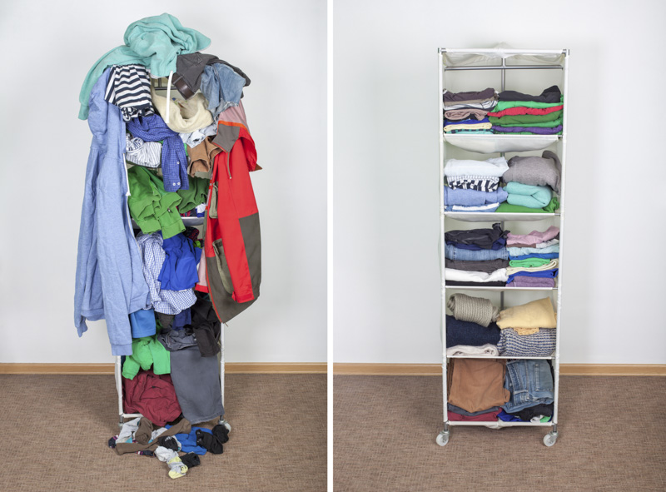
Why Data Structure
Introduction (CO1)

Slide 22
Why Data Structure
Introduction (CO1)
Human requirement with computer are going to complex day by day. To solve the complex requirements in efficient way we need this study.
Provide fastest solution of human requirements.
Provide efficient solution of complex problem.
>Space
>Time

Slide 23
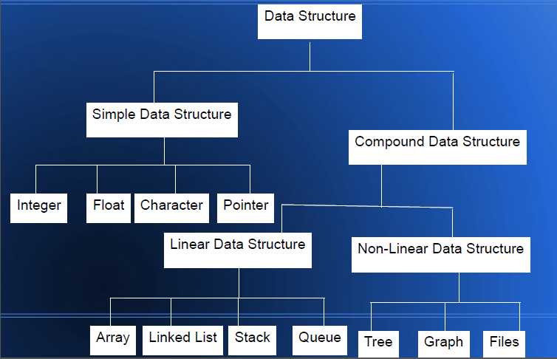
Classification of Data Structure
Introduction (CO1)

Slide 24
Classification of Data Structure ...
Introduction (CO1)
Simple Data Structure /Primitive data structure: used to represent the standard data types of any one of the computer languages (integer, Character, float etc.).
Compound Data Structure / Non Primitive Data Structure can be constructed with the help of any one of the primitive data structure and it is having a specific functionality. It can be designed by user. It can be classified as Linear and Non-Linear Data Structure.

Slide 25
Classification of Data Structure ...
Introduction (CO1)
Linear Data Structures: A linear data structure traverses the data elements sequentially, in which only one data element can directly be reached. Ex: Arrays, Linked Lists.
Non-Linear Data Structures: Every data item is attached to several other data items in a way that is specific for reflecting relationships. The data items are not arranged in a sequential structure. Ex: Trees, Graphs

Slide 26
Operation on Linear/Non-Linear Data Structure
Introduction (CO1)
Add an element
Delete an element
Traverse / Display
Sort the list of elements
Search for a data element

Slide 27
Types of Linear Data Structure
Introduction (CO1)
Array : An array is the collection of the variables of the same data type that are referenced by the common name.
int A[10], char B[10]

Slide 28
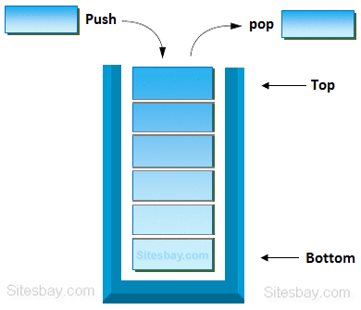
Types of Linear Data Structure….
Introduction (CO1)
Stack
Stack is a linear data structure in which the insertion and deletion operations are performed at only one end. In a stack, adding and removing of elements are performed at a single position which is known as "top". That means, a new element is added at top of the stack and an element is removed from the top of the stack. In stack, the insertion and deletion operations are performed based on LIFO(Last In First Out) principle.

Slide 29
Types of Linear Data Structure…
Introduction (CO1)
Queue is a linear data structure in which the insertion and deletion operations are performed at two different ends.
The insertion is performed at one end and deletion is performed at another end.
In a queue data structure, the insertion operation is performed at a position which is known as 'rear' and the deletion operation is performed at a position which is known as 'front'.
In queue data structure, the insertion and deletion operations are performed based on FIFO (First In First Out) principle.

Slide 30
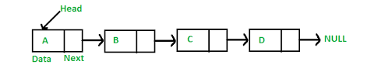
Types of Linear Data Structure…
Introduction (CO1)
LINKED LIST
When we want to work with an unknown number of data values, we use a linked list data structure to organize that data.
The linked list is a linear data structure that contains a sequence of elements such that each element links to its next element in the sequence. Each element in a linked list is called "Node".
200
300
250
100

Slide 31
Types of NON Linear Data Structure
Introduction (CO1)
Tree is a non-linear data structure which organizes data in hierarchical structure.

Slide 32
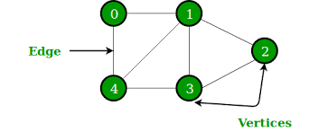
Types of NON Linear Data Structure..
Introduction (CO1)
Graph is a non-linear data structure. It contains a set of points known as nodes (or vertices) and a set of links known as edges (or Arcs). Here edges are used to connect the vertices.
Generally, a graph G is represented as G = ( V , E ), where V is set of vertices and E is set of edges.

Slide 33
Data Structures(CO1)
Data may be organized in many different ways; the logical or mathematical model of a particular organization of data is called a data structure.
The choice of a particular data model depends on two considerations.
It must be rich enough in structure to mirror the actual relationships of the data in the real world.
The structure should be simple enough that one can effectively process the data when necessary.

Slide 34
Data Structure Operations (CO1)
Traversing : Accessing each record exactly once
Searching: Finding the location of the record with a given key value
Inserting: Adding a new record to the structure.
Deleting: Removing a record from the structure.
Sorting: Arranging the records in some logical order
Merging: Combining the records in two different sorted files into a single sorted file

Slide 35
Algorithm(CO1)
An algorithm is a finite set of instructions or logic, written in order, to accomplish a certain predefined task.
Every Algorithm must satisfy the following properties:
Input- There should be 0 or more inputs supplied externally to the algorithm.
Output- There should be at least 1 output obtained.
Definiteness- Every step of the algorithm should be clear and well defined.
Finiteness- The algorithm should have finite number of steps.
Correctness- Every step of the algorithm must generate a correct output.

Slide 36
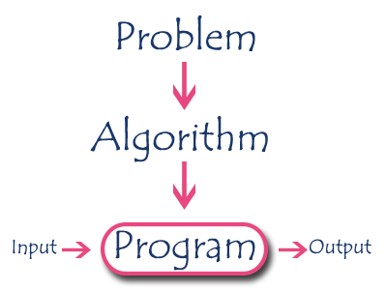
Algorithms
Introduction to Algorithms(CO1)
Algorithm is a step-by-step procedure, which defines a set of instructions to be executed in a certain order to get the desired output.
Algorithms are generally created independent of underlying languages, i.e. an algorithm can be implemented in more than one programming language.

Slide 37
Characteristics of an Algorithm
Introduction to Algorithms(CO1)
Unambiguous − Algorithm should be clear and unambiguous. Each of its steps (or phases), and their inputs/outputs should be clear and must lead to only one meaning.
Input − An algorithm should have 0 or more well-defined inputs.
Output − An algorithm should have 1 or more well-defined outputs, and should match the desired output.
Finiteness − Algorithms must terminate after a finite number of steps.
Independent − An algorithm should have step-by-step directions, which should be independent of any programming code

Slide 38
Example:
Introduction to Algorithms(CO1)
An algorithm to sum N natural numbers.
Sum(A[],n)
{
s=0;
for(i=1 to n) do
s=s+A[i]
return s
}
An algorithm to add to matrix
Matrixadd(A[][],B[][],C[][],m,n)
{
for(i=1 to n) do
for(j=1 to n) do
c[i][j]=a[i][j]+b[i][j]
}

Slide 39
Example
Sum of n natural number
Take input an array from the user.
Initialize sum = 0
Repeat step 4 from 1 to size of the array
Add all the elements in the sum one by one sum = sum+a[i]
Print sum

Slide 40
Efficiency of Algorithm(CO1)
An algorithm is said to be efficient and fast, if it takes less time to execute and consumes less memory space
In order to compare algorithms, we must have some criteria to measure the efficiency of our algorithms
The performance of an algorithm is measured on the basis of following properties :
Time Complexity
Space Complexity

Slide 41
Time and Space Complexity(CO1..)
Time complexity
Time Complexity is a way to represent the amount of time required by the program to run till its completion.
It's generally a good practice to try to keep the time required minimum, so that our algorithm completes its execution in the minimum time possible.
Space complexity
It is the amount of memory space required by the algorithm, during the course of its execution.
An algorithm generally requires space for following components
Instruction Space
Data Space
Environment Space

Slide 42
Asymptotic Notations(CO1)
Asymptotic analysis of an algorithm refers to defining the mathematical boundation/framing of its run-time performance.
Using asymptotic analysis, we can very well conclude the best case, average case, and worst case scenario of an algorithm.
Asymptotic analysis is input bound i.e., if there's no input to the algorithm, it is concluded to work in a constant time. Other than the "input" all other factors are considered constant.
Usually, the time required by an algorithm falls under three types −
Best Case − Minimum time required for program execution.
Average Case − Average time required for program execution.
Worst Case − Maximum time required for program execution.

Slide 43
Purpose of Asymptotic Notations
Introduction to Algorithms(CO1)
To simplify the running time of the function
To describe the behavior of the function.
To provide asymptotic bound.
To describe how the running time of an algorithm increases with increase in input size

Slide 44
Asymptotic Notations(contd..)
Following are the commonly used asymptotic notations to calculate the running time complexity of an algorithm:-
Ο Notation (Big Oh Notation)
Ω Notation (Omega Notation)
θ Notation (Theta Notation)

Slide 45
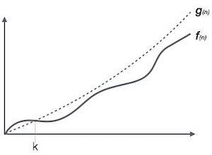
Big Oh Notation, Ο
The notation Ο(n) is the formal way to express the upper bound of an algorithm's running time. It measures the worst case time complexity or the longest amount of time an algorithm can possibly take to complete.
k=n₀
For example, for a function f(n)
Ο(f(n)) = { g(n) : there exists c > 0 and n₀ such that f(n) ≤ c.g(n) for all n > n₀. }

Slide 46
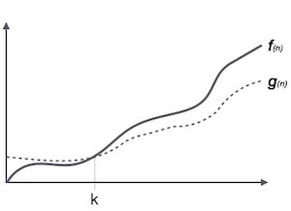
Omega Notation, Ω
The notation Ω(n) is the formal way to express the lower bound of an algorithm's running time. It measures the best case time complexity or the best amount of time an algorithm can possibly take to complete.
k=n₀
For example, for a function f(n)
Ω(f(n)) ≥ { g(n) : there exists c > 0 and n₀ such that g(n) ≤ c.f(n) for all n > n₀. }

Slide 47
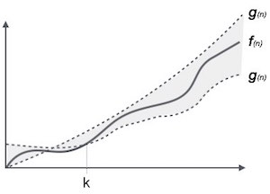
Theta Notation, θ
The notation θ(n) is the formal way to express both the lower bound and the upper bound of an algorithm's running time.
k=n₀
For example, for a function f(n)
θ(f(n)) = { g(n) if and only if g(n) = Ο(f(n)) and g(n) = Ω(f(n)) for all n > n₀. }

Slide 48
Common Asymptotic Notations
constant | Ο(1)
logarithmic | Ο(log n)
linear | Ο(n)
n log n | Ο(n log n)
quadratic | Ο(n²)
cubic | Ο(n³)
polynomial | n^{Ο(1)}
exponential | 2^{Ο(n)}

Slide 49
Time-space trade-off (CO1)
Most computers have a large amount of space, but not infinite space.
Also, most people are willing to wait a little while for a big calculation, but not forever.
So if your problem is taking a long time but not much memory, a space-time trade-off would let you use more memory and solve the problem more quickly.
Or, if it could be solved very quickly but requires more memory than you have, you can try to spend more time solving the problem in the limited memory.

Slide 50
Abstract Data Types (ADT) (CO1)
The Data Type is basically a type of data that can be used in different computer program.
It signifies the type like integer, float etc, the space like integer will take 4-bytes, character will take 1-byte of space etc.
The abstract data type is special kind of data type, whose behavior is defined by a set of values and set of operations.
The keyword “Abstract” is used as we can use these data types, we can perform different operations. But how those operations are working that is totally hidden from the user.
The ADT is made of with primitive data types, but operation logics are hidden.

Slide 51
Abstract Data Types (contd..)
Some examples of ADT are Stack, Queue, List etc.
Let us see some operations of those mentioned ADT −
Stack −
isFull(), This is used to check whether stack is full or not
isEmpty(), This is used to check whether stack is empty or not
push(x), This is used to push x into the stack
pop(), This is used to delete one element from top of the stack
Queue −
isFull(), This is used to check whether queue is full or not
isEmpty(), This is used to check whether queue is empty or not
insert(x), This is used to add x into the queue at the rear end
delete(), This is used to delete one element from the front end of the queue

Slide 52
Topic Objective
To learn about arrays and its types: single dimensional array and multi-dimensional array.
Understand basic representation of array.
To study applications of arrays.
To learn sparse matrices and their representations.

Slide 53
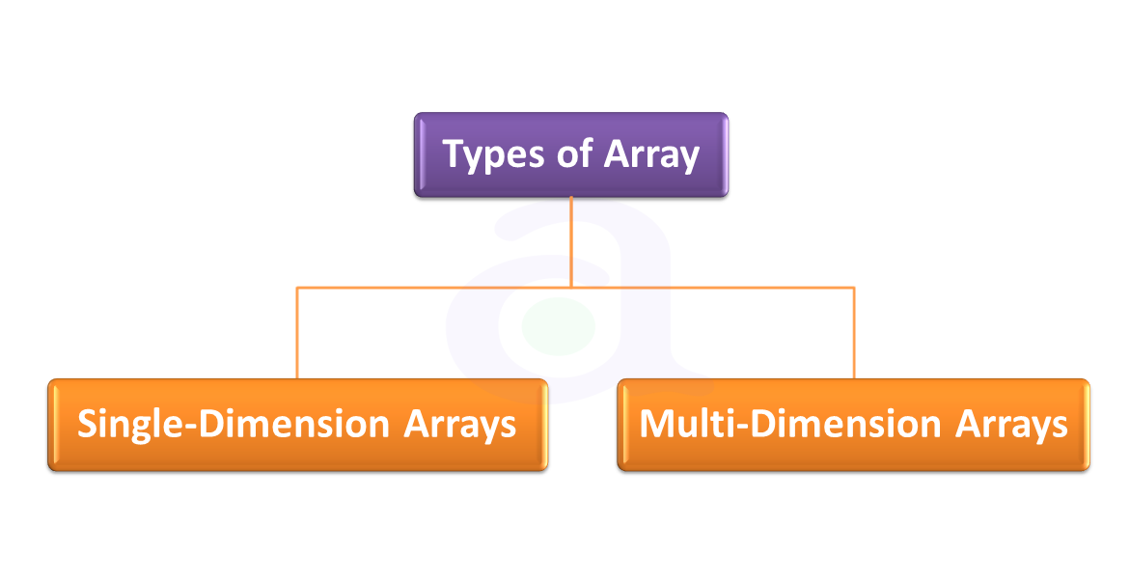
Arrays (CO1)
An array is a collection of variables of the same type that are referred to through a common name.
A specific element in an array is accessed by an index.
In Python, all arrays consist of contiguous memory locations.

Slide 54
Array Declaration
Like other variables, arrays must be explicitly declared so that the compiler can allocate space for them in memory.
The general form for declaring a single-dimension array is:
datatype var_name[size];
Here, type declares the base type of the array, which is the type of each element in the array
size defines how many elements the array will hold.

Slide 55
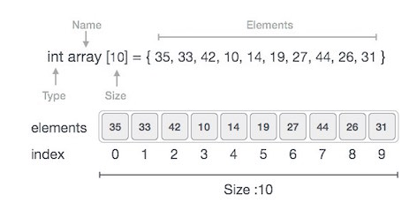
Array Declaration (Example)
Index starts with 0.
Array length is 10 which means it can store 10 elements.
Each element can be accessed via its index. For example, we can fetch an element at index 6 as 27.

Slide 56
Array Creation in Python
Array is created in Python by importing array module to the python program. Then the array is declared as shown below.
from array import *
arrayName = array(typecode, [initializers])

Slide 57
Array Creation in Python (Cont.)
Typecode are the codes that are used to define the type of value the array will hold. Some common type codes used are:
TYPE CODE | VALUE
b | Represents signed integer of size 1 byte
B | Represents unsigned integer of size 1 byte
c | Represents character of size 1 byte
i | Represents signed integer of size 2 bytes
I | Represents unsigned integer of size 2 bytes
f | Represents floating point of size 4 bytes
d | Represents floating point of size 8 bytes

Slide 58
Array Creation in Python (Example)
The below code creates an array named array1.
from array import *
array1 = array('i', [10,20,30,40,50])
for x in array1:
print(x)
When we compile and execute the above program, it produces the following result −
Output
10
20
30
40
50

Slide 59
Accessing elements of an Array
We can access each element of an array using the index of the element. The below code shows how
from array import *
array1 = array('i', [10,20,30,40,50])
print (array1[0])
print (array1[2])
When we compile and execute the above program, it produces the following result − which shows the element is inserted at index position 1.
Output
10
30

Slide 60
Insertion Operation
Insert operation is to insert one or more data elements into an array. Based on the requirement, a new element can be added at the beginning, end, or any given index of array.
Here, we add a data element at the middle of the array using the python in-built insert() method.
from array import *
array1 = array('i', [10,20,30,40,50])
array1.insert(1,60)
for x in array1:
print(x)

Slide 61
Insertion Operation (Cont.)
When we compile and execute the above program, it produces the following result which shows the element is inserted at index position
Output
10
60
20
30
40
50

Slide 62
Deletion Operation
Deletion refers to removing an existing element from the array and re-organizing all elements of an array.
Here, we remove a data element at the middle of the array using the python in-built remove() method.
from array import *
array1 = array('i', [10,20,30,40,50])
array1.remove(40)
for x in array1:
print(x)

Slide 63
Deletion Operation (Cont.)
When we compile and execute the above program, it produces the following result which shows the element is removed from the array.
Output
10
20
30
50

Slide 64
Search Operation (Cont.)
You can perform a search for an array element based on its value or its index.
Here, we search a data element using the python in-built index() method.
from array import *
array1 = array('i', [10,20,30,40,50])
print (array1.index(40))
When we compile and execute the above program, it produces the following result which shows the index of the element. If the value is not present in the array then the program returns an error.
Output
3

Slide 65
Update Operation
Update operation refers to updating an existing element from the array at a given index.
Here, we simply reassign a new value to the desired index we want to update.
from array import *
array1 = array('i', [10,20,30,40,50])
array1[2] = 80
for x in array1:
print(x)

Slide 66
Update Operation (Cont.)
When we compile and execute the above program, it produces the following result which shows the new value at the index position 2.
Output
10
20
80
40
50

Slide 67
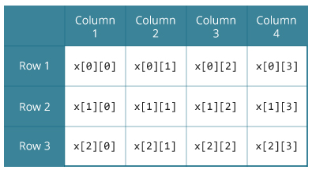
Multidimensional Array (CO1)
In C programming, you can create an array of arrays.
These arrays are known as multidimensional arrays.
For example,
float x[3][4];
Here, x is a two-dimensional (2d) array. The array can hold 12 elements. You can think the array as a table with 3 rows and each row has 4 columns as shown in figure.

Slide 68
Multidimensional Array
Similarly, you can declare a three-dimensional (3d) array.
For example,
float y[2][4][3];
Here, the array y can hold 24 elements.

Slide 69
Representation of arrays (CO1)
A 2D array’s elements are stored in continuous memory locations. It can be represented in memory using any of the following two ways: 1. Row-Major Order 2. Column-Major Order

Slide 70
Row-Major Order
Row Major Order is a method of representing multi dimension array in sequential memory.
In this method elements of an array are arranged sequentially row by row.
Thus elements of first row occupies first set of memory locations reserved for the array, elements of second row occupies the next set of memory and so on.
Consider a Two Dimensional Array consist of N rows and M columns. It can be stored sequentially in memory row by row as shown below:
Row 0 | A[0,0] | A[0,1] | ................. | A[0,M-1]
Row 1 | A[1,0] | A[1,1] | ................. | A[1,M-1]
 | ................................................................
Row N-1 | A[N-1,0] | A[N-1,1] | ................. | A[N-1,M-1]

Slide 71
Row-Major Order
Example: Consider following example in which a two dimensional array consist of two rows and four columns is stored sequentially in row major order as:
2000 | A[0][0] | Row 0
2002 | A[0][1]
2004 | A[0][2]
2006 | A[0][3]
2008 | A[1][0] | Row 1
2010 | A[1][1]
2012 | A[1][2]
2014 | A[1][3]

Slide 72
Row-Major Order
The Location of element A[i, j] can be obtained by evaluating expression:
LOC (A [i, j]) = Base_Address + W [M (i-L1) + (j-L2)]
Here,
Base_Address is the address of first element in the array.
W is the word size. It means number of bytes occupied by each element.
N is number of rows in array.
M is number of columns in array.
L1 is lower bound of row.
L2 is lower bound of column.

Slide 73
Row-Major Order
Suppose we want to calculate the address of element A [1, 2].
It can be calculated as follow:
Here,
Base_Address = 2000, W= 2, M=4, N=2, i=1, j=2
LOC (A [i, j])=Base_Address + W [M (i-L1) + (j-L2)]
LOC (A[1, 2])=2000 + 2 *[4*(1) + 2]
=2000 + 2 * [4 + 2]
=2000 + 2 * 6
=2000 + 12
=2012

Slide 74
Column Major Order
Column Major Order is a method of representing multidimensional array in sequential memory. In this method elements of an array are arranged sequentially column by column. Thus elements of first column occupies first set of memory locations reserved for the array, elements of second column occupies the next set of memory and so on. Consider a Two Dimensional Array consist of N rows and M columns. It can be stored sequentially in memory column by column as shown below:
Column 0 | A[0,0] | A[1,0] |  | A[N-1,0]
Column 1 | A[0,1] | A[1,1] |  | A[N-1,1]
Column N-1 | A[0,M-1] | A[1,M-1] |  | A[N-1,M-1]

Slide 75
Column Major Order
Example: Consider following example in which a two dimensional array consist of two rows and four columns is stored sequentially in Column Major Order as:
2000 | A[0][0] | Column 0
2002 | A[1][0]
2004 | A[0][1] | Column 1
2006 | A[1][1]
2008 | A[0][2] | Column 2
2010 | A[1][2]
2012 | A[0][3] | Column 3
2014 | A[1][3]

Slide 76
Column Major Order
The Location of element A[i, j] can be obtained by evaluating expression:
LOC (A [i, j]) = Base_Address + W [N (j-L2) + (i-L1)]
Here,
Base_Address is the address of first element in the array.
W is the word size. It means number of bytes occupied by each element.
N is number of rows in array.
M is number of columns in array.
L1 is lower bound of row.
L2 is lower bound of column.

Slide 77
Column Major Order
Suppose we want to calculate the address of element A [1, 2].
It can be calculated as follow:
Here,
Base_Address = 2000, W= 2, M=4, N=2, i=1, j=2
LOC (A [i, j])=Base_Address + W [N (j-L2) + (i-L1)]
LOC (A[1, 2])=2000 + 2 *[2*(2) + 1]
=2000 + 2 * [4 + 1]
=2000 + 2 * 5
=2000 + 10
=2010

Slide 78
Application of arrays (CO1)
Arrays are used to Store List of values
Arrays are used to Perform Matrix Operations
Arrays are used to implement Search Algorithms
Linear search
Binary search
Arrays are used to implement Sorting Algorithms
Insertion sort
Selection sort
Quick sort
Arrays are used to implement Data Structures
Stack using array
Queue using array
Arrays are also used to implement CPU Scheduling Algorithms

Slide 79
Sparse Matrix (CO1)
A matrix is a two-dimensional data object made of m rows and n columns, therefore having total m x n values. If most of the elements of the matrix have 0 value, then it is called a sparse matrix.
Why to use Sparse Matrix instead of simple matrix ?
Storage: There are lesser non-zero elements than zeros and thus lesser memory can be used to store only those elements.
Computing time: Computing time can be saved by logically designing a data structure traversing only non-zero elements..
Example
0 0 3 0 4
0 0 5 7 0
0 0 0 0 0
0 2 6 0 0

Slide 80
Sparse Matrix Representation
Representing a sparse matrix by a 2D array leads to wastage of lots of memory as zeroes in the matrix are of no use in most of the cases. So, instead of storing zeroes with non-zero elements, we only store non-zero elements. This means storing non-zero elements with triples- (Row, Column, value).
Sparse Matrix Representations can be done in many ways following are two common representations:
Array representation
Linked list representation

Slide 81
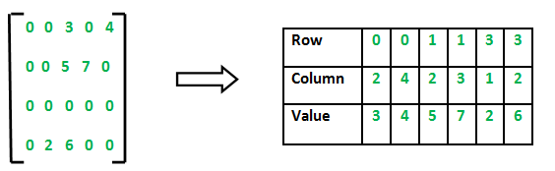
Sparse Matrix Representation
Method 1: Using Arrays
2D array is used to represent a sparse matrix in which there are three rows named as
Row: Index of row, where non-zero element is located
Column: Index of column, where non-zero element is located
Value: Value of the non zero element located at index – (row, column)

Slide 82
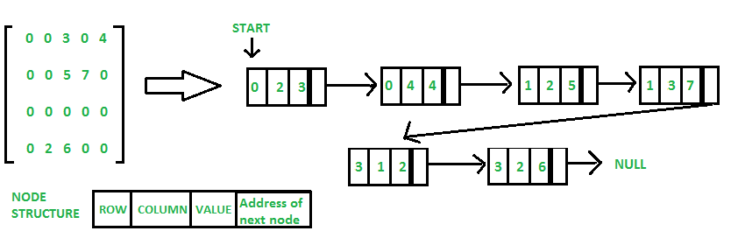
Sparse Matrix Representation
Method 2: Using Linked Lists
In linked list, each node has four fields. These four fields are defined as:
Row: Index of row, where non-zero element is located
Column: Index of column, where non-zero element is located
Value: Value of the non zero element located at index – (row,column)
Next node: Address of the next node

Slide 83
Topic Objective
To learn Searching
Linear search
Binary search

Slide 84
Searching
Searching is a process of finding a particular element among several given elements.
The search is successful if the required element is found.
Otherwise, the search is unsuccessful.

Slide 85
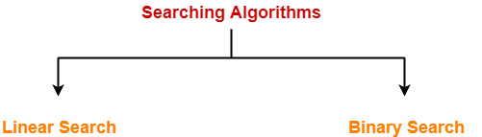
Searching Algorithms
Searching Algorithms are a family of algorithms used for the purpose of searching.
The searching of an element in the given array may be carried out in the following two ways-
Linear Search
Binary Search

Slide 86
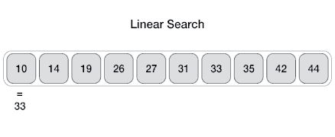
Linear Search
Linear search is the simplest search algorithm and often called sequential search.
In this type of searching, we simply traverse the list completely and match each element of the list with the item whose location is to be found.
If the match found then location of the item is returned otherwise the algorithm return NULL.

Slide 87
Linear Search Algorithm
LINEAR_SEARCH(A, N, VAL)
Step 1: [INITIALIZE] SET POS = -1
Step 2: [INITIALIZE] SET I = 1
Step 3: Repeat Step 4 while I<=N
Step 4: IF A[I] = VAL SET POS = I PRINT POS Go to Step 6 [END OF IF] SET I = I + 1 [END OF LOOP]
Step 5: IF POS = -1 PRINT " VALUE IS NOT PRESENTIN THE ARRAY " [END OF IF]
Step 6: EXIT

Slide 88
Linear Search Algorithm Complexity
Complexity | Best Case | Average Case | Worst Case
Time | O(1) | O(n) | O(n)
Space |  |  | O(1)

Slide 89
Linear Search Explained
Linear Search
https://www.youtube.com/watch?v=C46QfTjVCNU&feature=youtu.be

Slide 90
Binary Search
Binary Search is one of the fastest searching algorithms.
It is used for finding the location of an element in a linear array.
It works on the principle of divide and conquer technique.
Binary Search Algorithm can be applied only on Sorted arrays.
So, the elements must be arranged in-
Either ascending order if the elements are numbers.
Or dictionary order if the elements are strings.

Slide 91
Binary Search Algorithm
BINARY_SEARCH(A, lower_bound, upper_bound, VAL)
Step 1: [INITIALIZE] SET BEG = lower_bound END = upper_bound, POS = - 1
Step 2: Repeat Steps 3 and 4 while BEG <=END
Step 3: SET MID = (BEG + END)/2
Step 4: IF A[MID] = VAL SET POS = MID PRINT POS Go to Step 6 ELSE IF A[MID] > VAL SET END = MID - 1 ELSE SET BEG = MID + 1 [END OF IF] [END OF LOOP]

Slide 92
Binary Search Algorithm (contd..)
Step 5: IF POS = -1 PRINT "VALUE IS NOT PRESENT IN THE ARRAY" [END OF IF]
Step 6: EXIT

Slide 93
Binary Search Complexity
SN | Performance | Complexity
1 | Worst case | O(log n)
2 | Best case | O(1)
3 | Average Case | O(log n)
4 | Worst case space complexity | O(1)

Slide 94
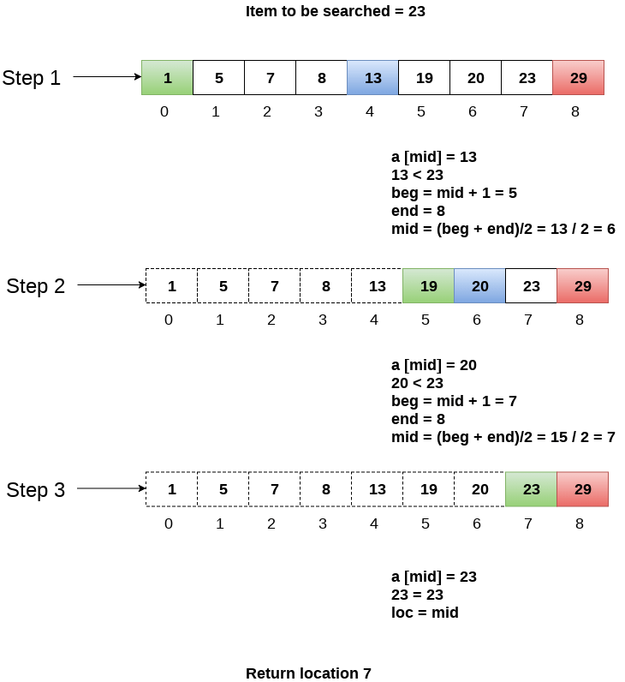
Binary Search Example

Slide 95
Binary Search Explained
Binary Search
https://www.youtube.com/watch?v=V_T5NuccwRA&feature=youtu.be

Slide 96
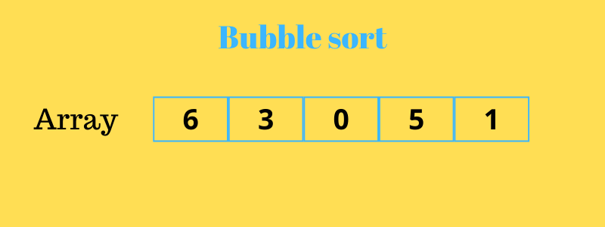
Sorting Using Array(CO1)
Sorting using Array(CO1)
Bubble Sort is the simplest sorting algorithm that works by repeatedly swapping the adjacent elements if they are in wrong order.

Slide 97
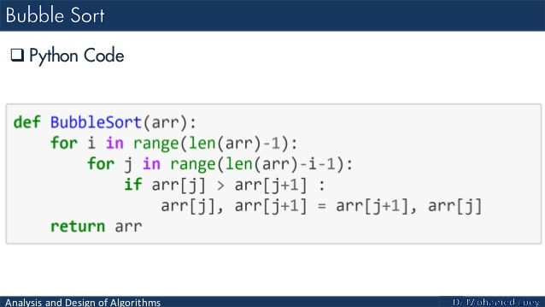
Sorting using Array(CO1)

Slide 98
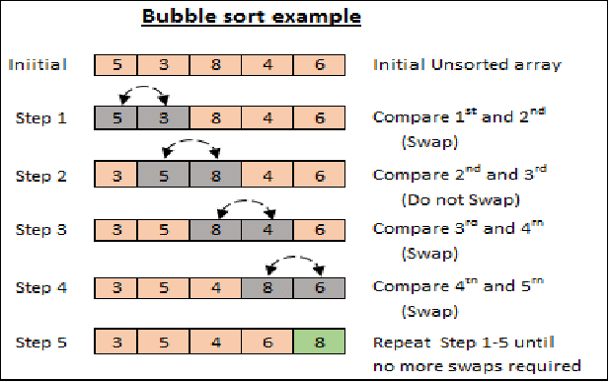
Sorting using Array(CO1)
Bubble sort Illustration

Slide 99
Sorting using Array(CO1)
Insertion Sort Algorithm
Set a marker for the sorted section, after the first element.
Repeat the following until unsorted section is empty:
Select the first unsorted element
Swap other elements to the right to create the correct position and shift the unsorted elements
Advance the marker to the right one element.

Slide 100
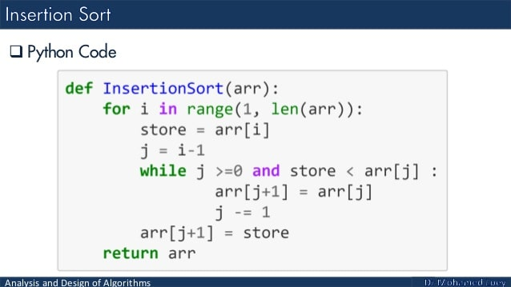
Sorting using Array(CO1)

Slide 101
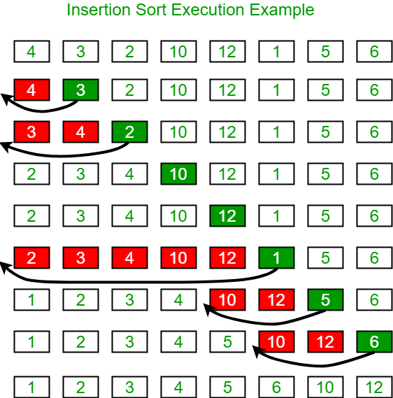
Sorting using Array(CO1)

Slide 102
Sorting using Array(CO1)
Selection sort
The selection sort algorithm sorts an array by repeatedly finding the minimum element (considering ascending order) from unsorted part and putting it at the beginning.
The algorithm maintains two subarrays in a given array.
The subarray which is already sorted.
Remaining subarray which is unsorted.
Select the lowest element in the remaining array
Bring it to the starting position
Change the counter for unsorted array by one.

Slide 103
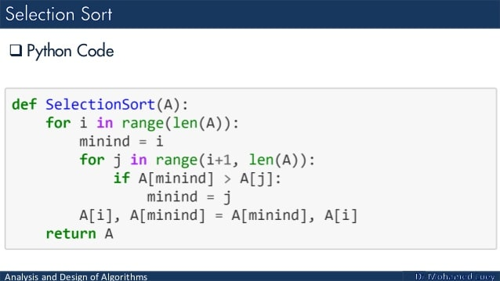
Sorting using Array(CO1)

Slide 104
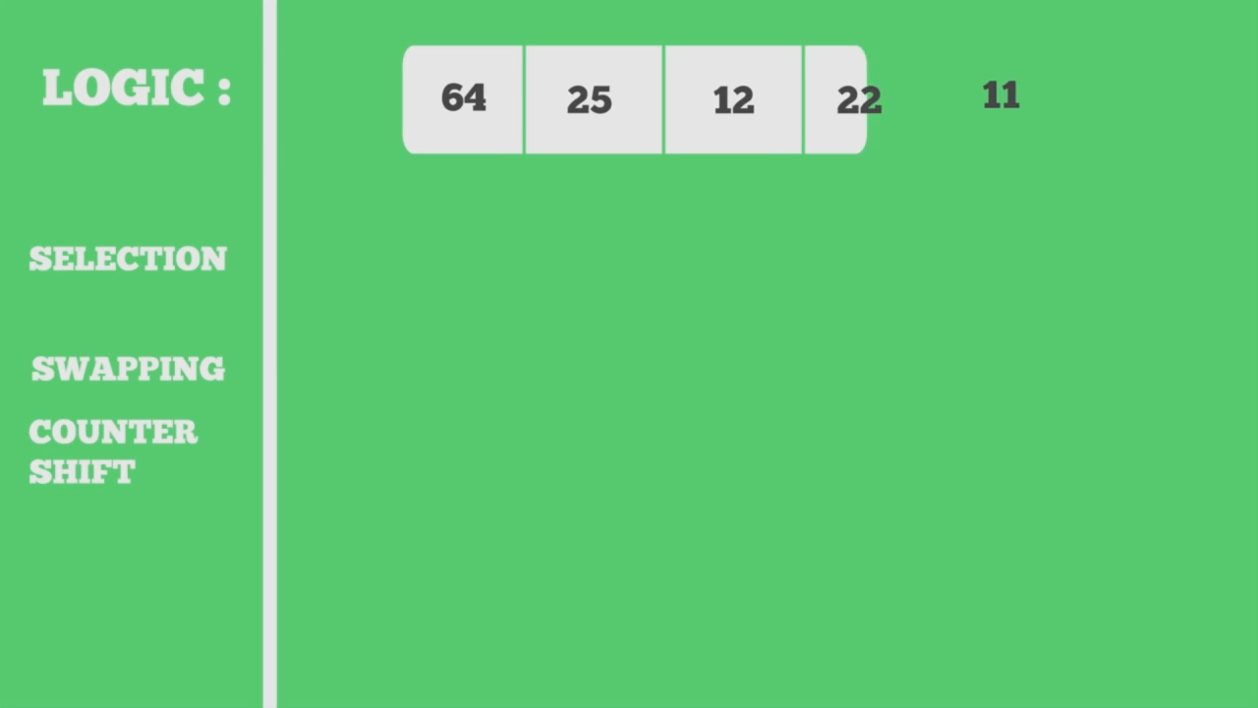
Sorting using Array(CO1)
Selection sort

Slide 105
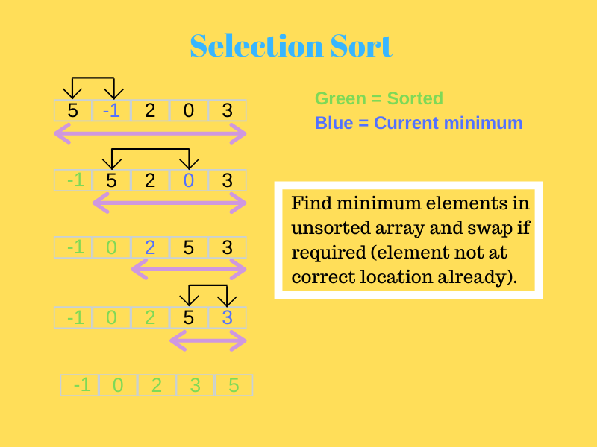
Sorting using Array(CO1)

Slide 106
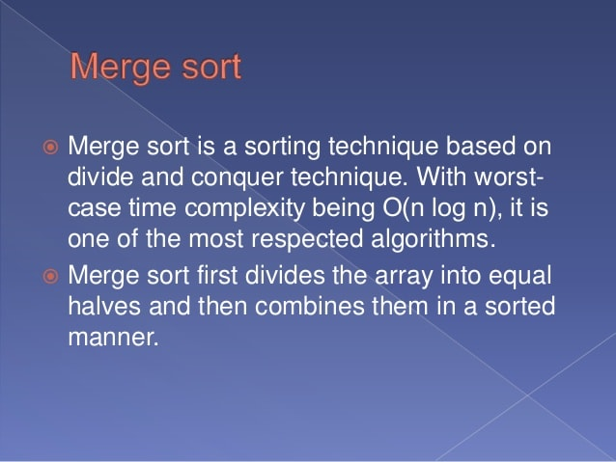
Sorting using Array(CO1)

Slide 107
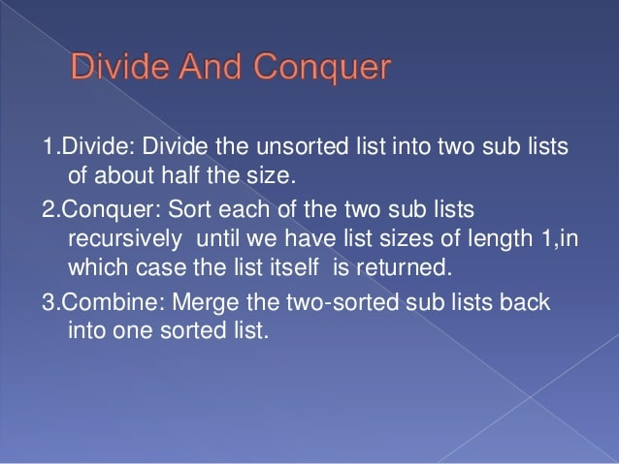
Sorting using Array(CO1)

Slide 108
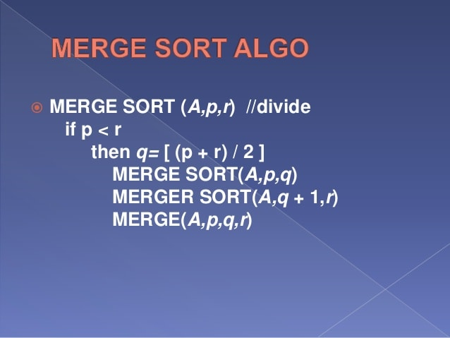
Sorting using Array(CO1)

Slide 109
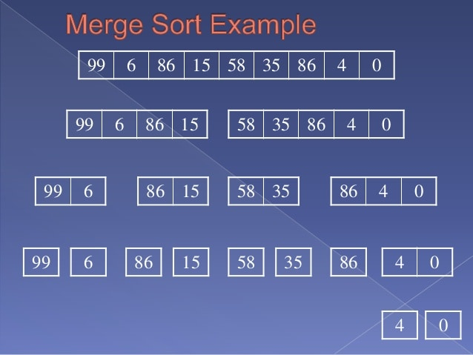
Sorting using Array(CO1)

Slide 110
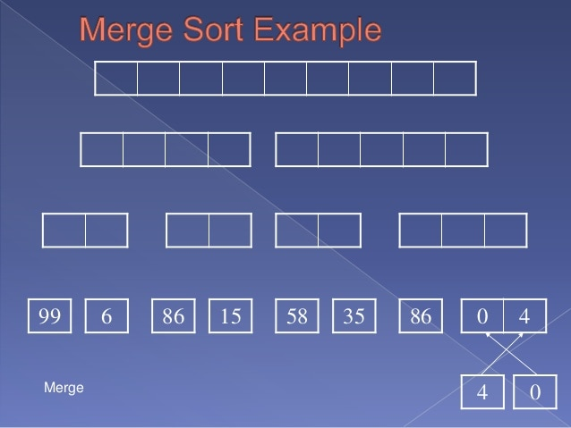
Sorting using Array(CO1)

Slide 111
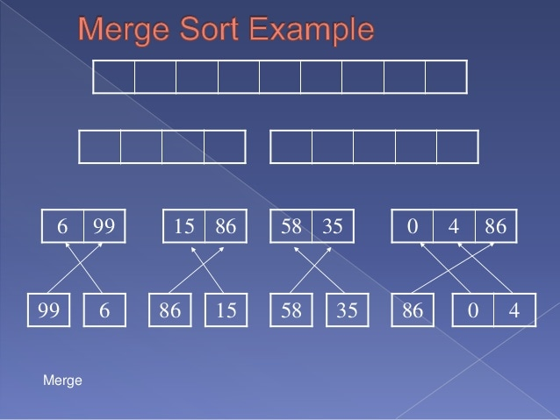
Sorting using Array(CO1)

Slide 112
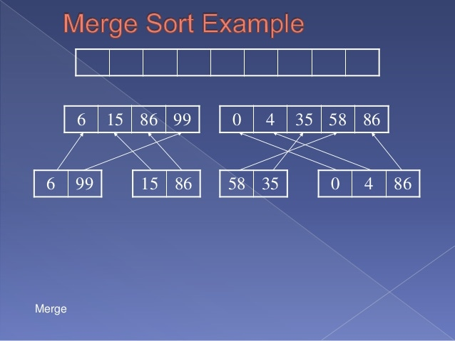
Sorting using Array(CO1)

Slide 113
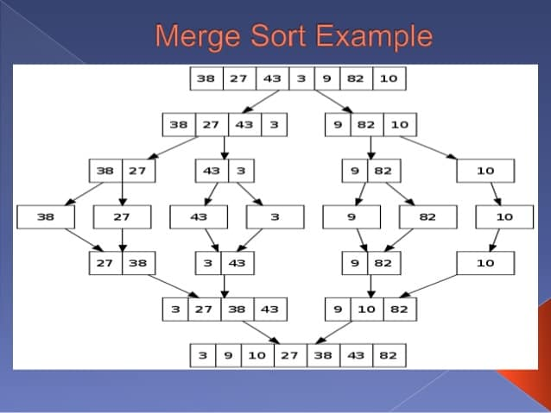
Sorting using Array(CO1)

Slide 114
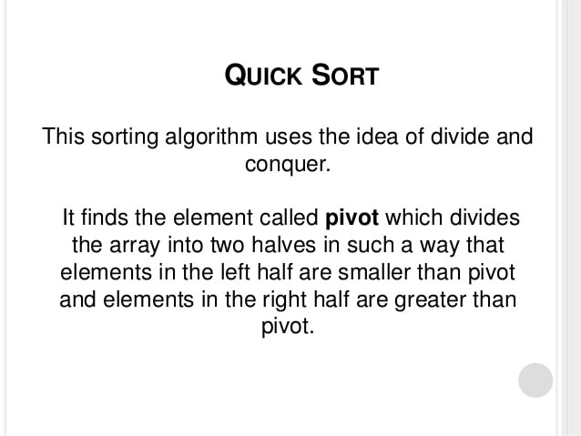
Sorting using Array(CO1)

Slide 115
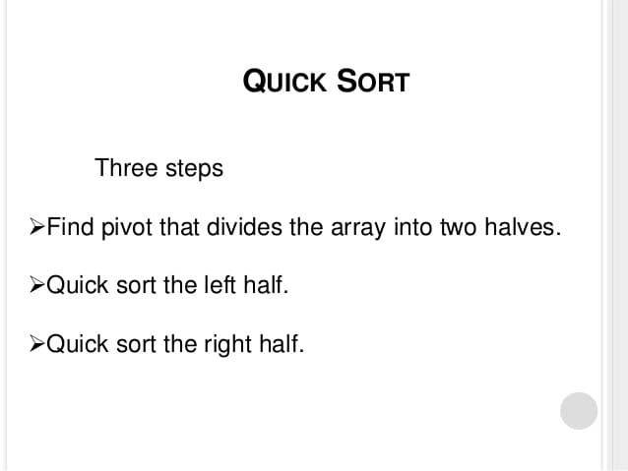
Sorting using Array(CO1)

Slide 116
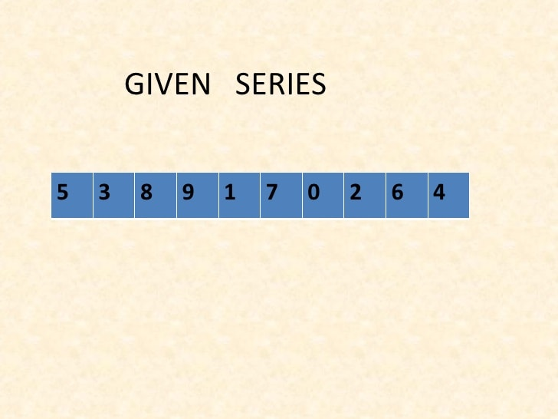
Sorting using Array(CO1)

Slide 117
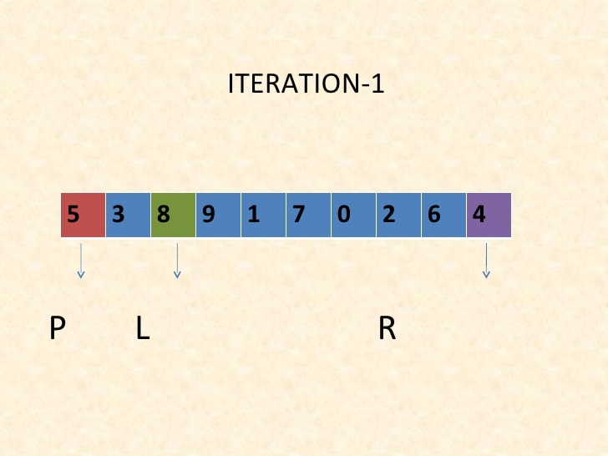
Sorting using Array(CO1)

Slide 118
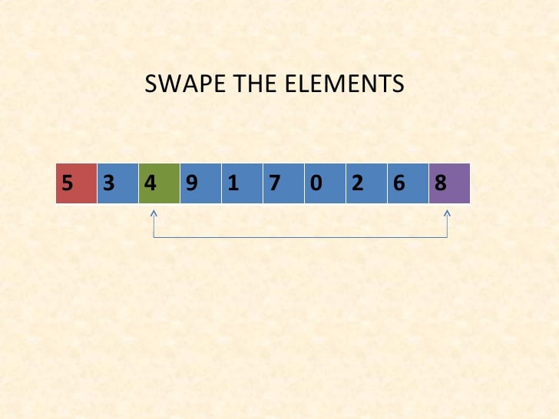
Sorting using Array(CO1)

Slide 119
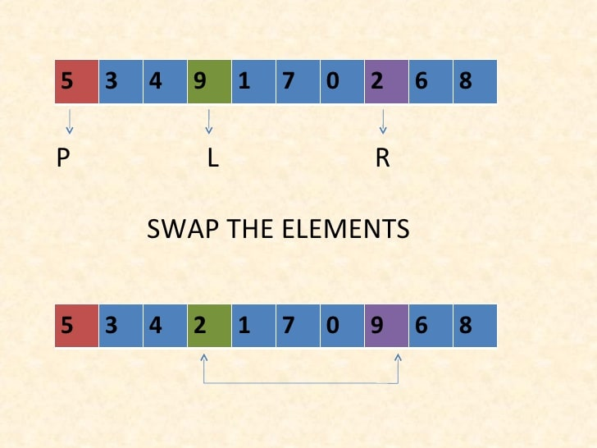
Sorting using Array(CO1)

Slide 120
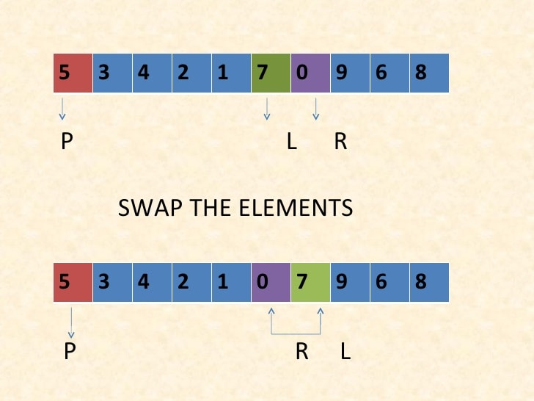
Sorting using Array(CO1)

Slide 121
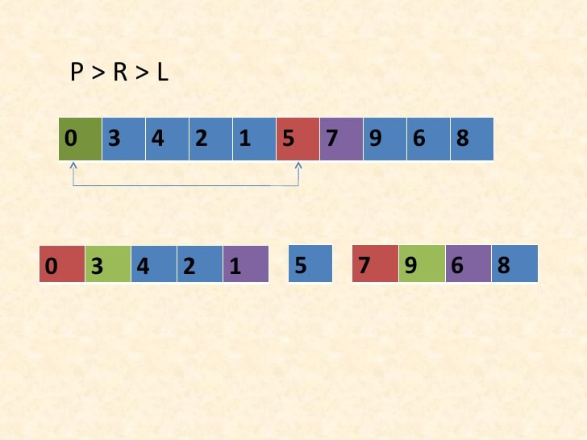
Sorting using Array(CO1)

Slide 122
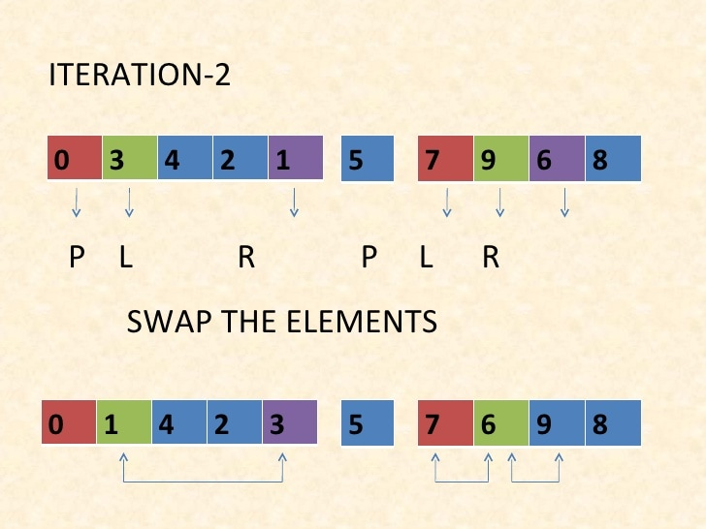
Sorting using Array(CO1)

Slide 123
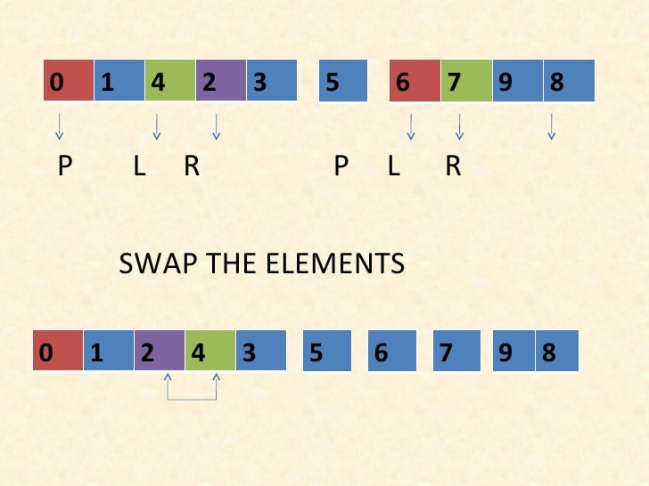
Sorting using Array(CO1)

Slide 124
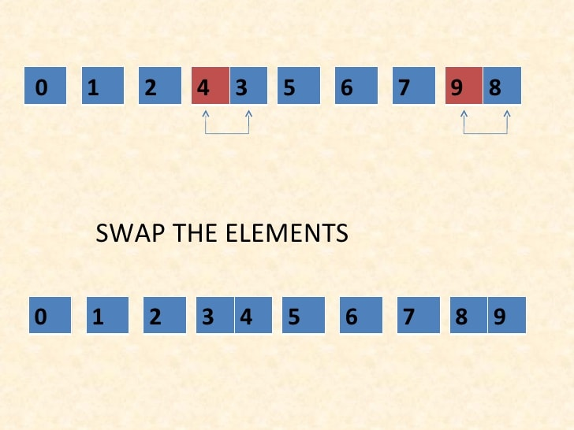
Sorting using Array(CO1)

Slide 125
Daily Quiz
1. Where is linear searching used? a) When the list has only a few elements b) When performing a single search in an unordered list c) Used all the time d) When the list has only a few elements and When performing a single search in an unordered list
2. What is the best case for linear search? a) O(nlogn) b) O(logn) c) O(n) d) O(1)

Slide 126
Daily Quiz
3. What is the best case and worst case complexity of ordered linear search? a) O(nlogn), O(logn) b) O(logn), O(nlogn) c) O(n), O(1) d) O(1), O(n)

Slide 127
MCQ s
Which of these best describes an array? a) A data structure that shows a hierarchical behaviour b) Container of objects of similar types c) Arrays are immutable once initialised d) Array is not a data structure
How do you initialize an array in C? a) int arr[3] = (1,2,3); b) int arr(3) = {1,2,3}; c) int arr[3] = {1,2,3}; d) int arr(3) = (1,2,3);

Slide 128
MCQ s
What are the advantages of arrays? a) Objects of mixed data types can be stored b) Elements in an array cannot be sorted c) Index of first element of an array is 1 d) Easier to store elements of same data type
Elements in an array are accessed _____________ a) randomly b) sequentially c) exponentially d) logarithmically

Slide 129
MCQ s
In linked list each node contain minimum of two fields. One field is data field to store the data second field is? A. Pointer to character B. Pointer to integer C. Pointer to node D. Node
Linked list data structure offers considerable saving in
A. Computational Time B. Space Utilization C. Space Utilization and Computational Time D. None of the mentioned

Slide 130
Glossary Question
i. Algorithm ii. Abstract Data type iii.Asymptotic Analysis iv. Binary search
Answer the questions.
a. A standard recursive algorithm for finding the record with a given search key value within a sorted list.
b. A process followed to solve a problem.
c. The specification of a data type with some language.
d.Computer Program by identifying its growth rate.

Slide 131
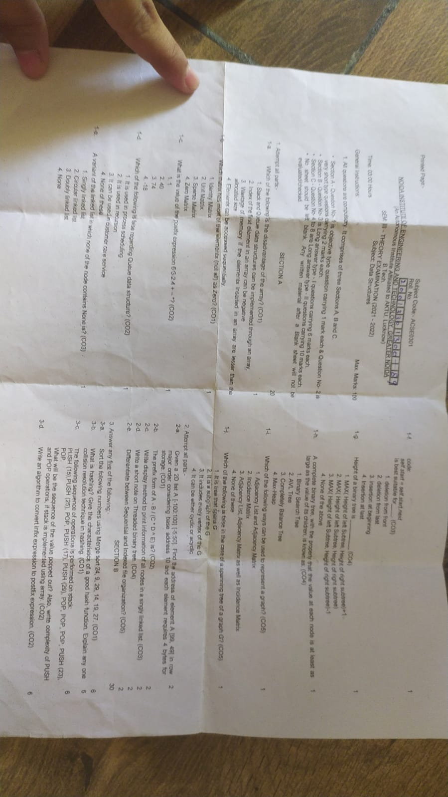
Last year Question Paper

Slide 132
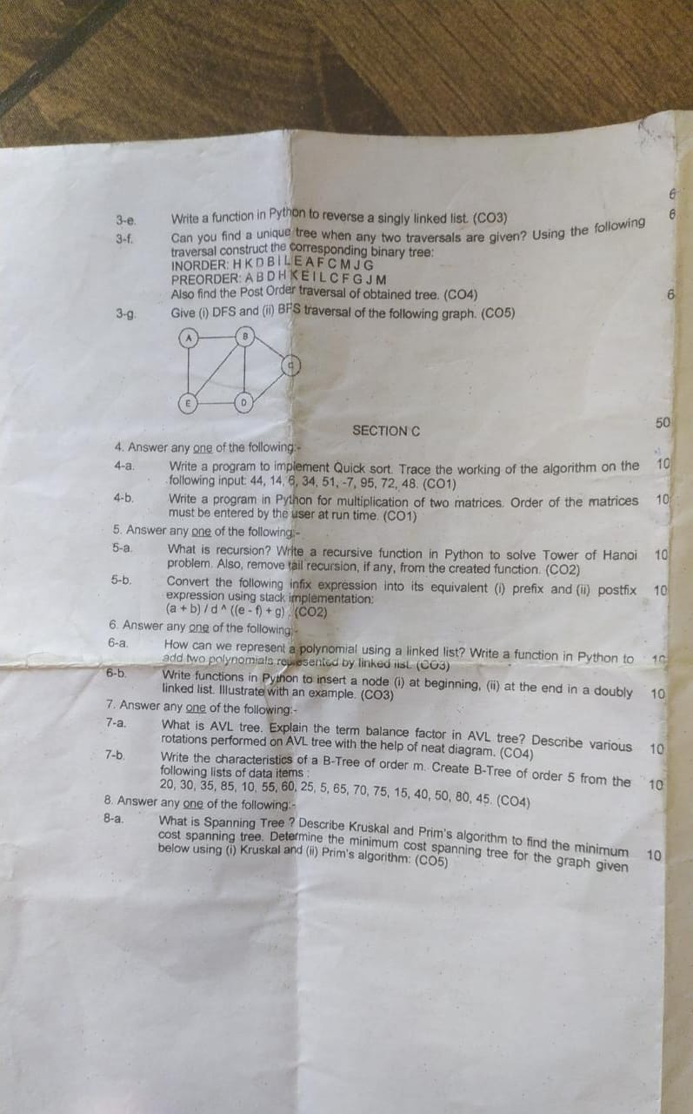
Last year Question Paper

Slide 133
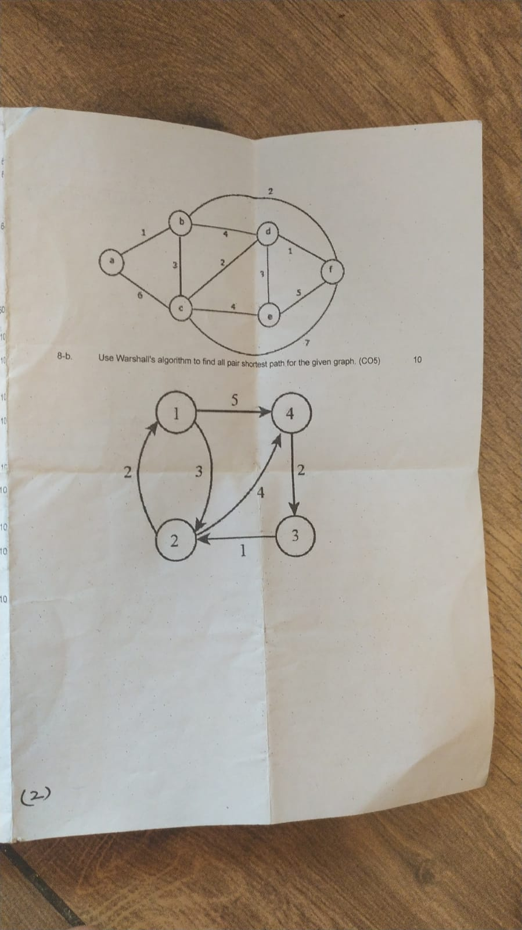
Last year Question Paper

Slide 134
Old Question Papers
http://www.aktuonline.com/papers/btech-cs-3-sem-data-structures-kcs301-2020.html
http://www.aktuonline.com/papers/btech-cs-3-sem-data-structures-rcs-305-2018-19.html
http://www.aktuonline.com/papers/btech-cs-3-sem-data-structures-rcs-305-2017-18.html
http://www.aktuonline.com/papers/btech-cs-3-sem-data-structures-using-c-ncs-301-2016-17.html
https://www.aktuonline.com/papers/btech-cs-3-sem-data-structures-kcs301-2020.html
https://firstranker.com/fr/frdA290120A1345373/download-aktu-b-tech-3rd-sem-2018-2019-data-structures-rcs-305-question-paper

Slide 135
Expected Questions for University Exam
What is doubly linked list? What are its applications? Explain how an element can be deleted from doubly linked list using python program.
What are the merits and demerits of array? Given two arrays of integers in ascending order, develop an algorithm to merge these arrays to form a third array sorted in ascending order.
How can you represent a sparse matrix in memory?
List the various operations on linked list.
What do you understand by time and space complexity?
Define the various asymptotic notations. Derive the O-notation for linear search.
Write a program in c to delete a specific element in single linked list. Double linked list takes more space than single linked list for storing one extra address. Under what condition, could a double linked list more beneficial than single linked list.

Slide 136
Summary
Knowledge of basic data structures is important for understanding organization of data.
Understanding of array and link list is compulsory to implement other data structures.

Slide 137
References
Aaron M. Tenenbaum, Yedidyah Langsam and Moshe J. Augenstein, “Data Structures Using C and C++”, PHI Learning Private Limited, Delhi India
Horowitz and Sahani, “Fundamentals of Data Structures”, Galgotia Publications Pvt Ltd Delhi India.
Lipschutz, “Data Structures” Schaum’s Outline Series, Tata McGraw-hill Education (India) Pvt. Ltd.
Thareja, “Data Structure Using C” Oxford Higher Education.
AK Sharma, “Data Structure Using C”, Pearson Education India.
Michael T. Goodrich, Roberto Tamassia, David M. Mount “Data Structures and Algorithms in C++”, Wiley India.
. P. S. Deshpandey, “C and Data structure”, Wiley Dreamtech Publication.

Slide 138
Thank You

